Slide 1
Lecture 3 sensory encoding
How does the nervous system represent sensory information?
What stimuli drive neurons, let’s call them sensory ‘features’?
How can a neural code be decoded?
How are the set of important sensory features allocated to neurons?
How are mechanisms used to construct a sensory representation?
How do properties of sensory neurons influence behavior?
Why is a particular neural code advantageous (or optimal)?
Why are particular mechanisms advantageous?
What design principles influence sensory systems, can they be used for artificial systems?

Slide 2
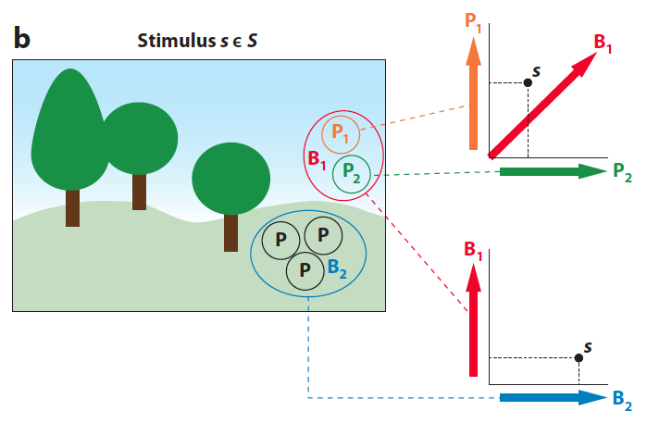
Stimulus space: A geometrical representation of input
Not the same as “visual space”:
receptors are dimensions, not points

Slide 3
Stimulus space: A geometrical representation of input
Receptive field: a direction of sensitivity
All stimuli
Stimuli producing spikes
Preferred direction in stimulus space

Slide 4
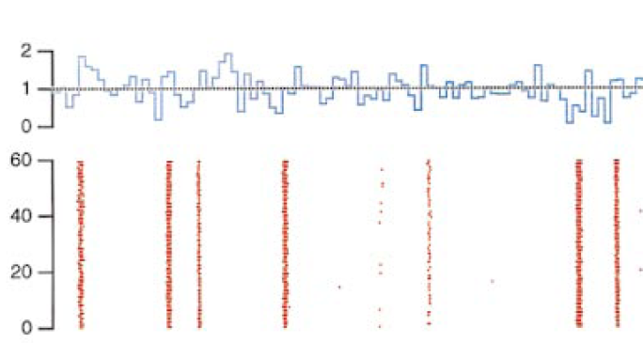
Receptive field: What stimuli makes the neuron respond?
Light
Intensity
Trial
Notes:
Important questions about how a neuron can convey information

Slide 5
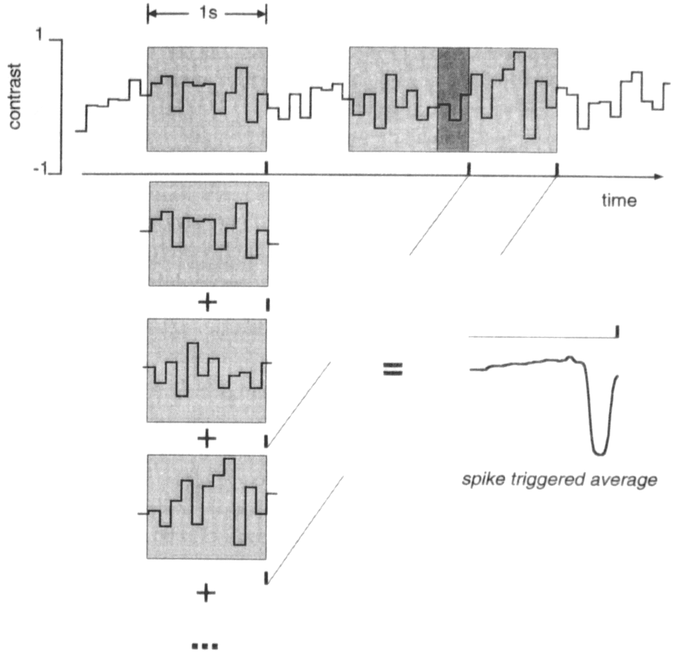
Receptive field: What stimuli makes the neuron respond?
Reverse correlation for a spiking neuron
1
Light intensity
0
0
Spike triggered average
(mean effective stimulus)
Spikes, MIT press Rieke et al ( 1997)
Notes:
This diagram indicates a commonly used procedure for answering the question:
“What makes a neuron respond?”
The method is called reverse correlation.
A Gaussian white noise stimulus is presented to the retina, and the spiking response is recording (spikes are black tick marks underneath the light intensity trace).
Prior to each spike, a 1 second segment of stimulus is extracted. When all 1 second segments are averaged, this yields so-called spike-triggered average stimulus.

Slide 6
What stimulus makes the neuron respond?
White noise analysis
For a Gaussian white-noise stimulus, the reverse correlation gives the input that is transmitted with greatest sensitivity
Gaussian distribution
1
Light intensity
0
0
Reverse correlation
(Spike triggered average)
Notes:
The spike-triggered average (STA) is selecting the average stimulus out of a large set of possible stimuli. If the chosen set of stimuli are random, this experiment tells you something. However, if you did this with something like a periodic stimulus (a repeatedly flashing light), then the STA is guaranteed to be periodic, because there is no other possible stimuli.
And so the procedure of ‘white-noise analysis’ relies on the fact that the stimulus is random. White noise means that the stimulus contains all possible temporal frequencies in equal power. Another way of saying this is that the power spectrum is flat. Visual white noise looks like a television that’s not tuned to a station (‘snow’). Auditory white noise sounds like ‘shhhh’.
A special case of white noise is drawn from a Gaussian distribution. In Gaussian white noise, all possible temporal patterns and frequencies occur with equal probability, so if a cell preferentially responds to one type of pattern, it’s because the cell really has that preference, not because the stimulus is enriched for that pattern.

Slide 7
What stimulus makes the neuron respond?
Reverse correlation
Continuous
Discrete
For spikes, this is proportional to the spike-triggered average

Slide 8
These equations give a mathematical definition for reverse correlation. If we think about signals as being continuous, then it is appropriate to use the integral. However in modern neuroscience, all continuous signals are sampled and digitized, and then integrals are computed by summing over digitized values. Even if you take a photograph on a film camera, the journal will digitize when they publish it. Thus it is appropriate to consider the ‘discrete’ form of this equation, where the summation (Σ) sign is used. This is also easier to translate into something like a computer program or spreadsheet.
r(t): the response as a function of time
s(t): the stimulus as a function of time
T: The length of the experiment
∆t: How much points are separated in time, for example 1 s, or 1 ms.
τ: The time delay of the stimulus relative to the response. When
= 0, the equation becomes:
In other words, for C(0), the response, r(t), is multiplied by the stimulus, s(t) that occurs at the same time for every time point. All results are then summed. Unless there is an instantaneous effect between s(t) and r(t), this C(0) should be close to zero.
Likewise, when τ = 1, the equation is:
In this case the response at time t, r(t), is multiplied with the stimulus that occurred one time point in the past, s(t-1), for every time point. In other words, the stimulus is shifted one time point before multiplying. If the stimulus caused the response with a delay of one time point, there will likely be a positive or negative correlation.
When τ = -1, the equation is:
If there is no correlation between the stimulus at one point of time and another point in time, the response should not be correlated with the stimulus in the future, and so the reverse correlation C(τ) for τ<0 should be close to zero. This is a good reality check on ones experiments and analysis.
Why correlation?
A correlation can be thought of as an average over many products. If two signals x(t) and y(t) are positively correlated, then x(t) will be positive when y(t) is positive, and x(t) multiplied by y(t) will be > 0. If x(t) and y(t) are unrelated, then on average, x(t) multiplied by y(t) will be zero. If x(t) and y(t) are negatively correlated, x(t) multiplied by y(t) will be < 0.

Slide 9
Computing the most effective stimulus (Bussgang’s theorem)
Prior stimulus distribution
Threshold
Stimuli causing spikes
Prior stimulus distribution
Threshold
Stimuli causing spikes
Direction of
maximal sensitivity
Direction of
maximal sensitivity
Stimulus dimension 2
Spike-triggered
average stimulus
Spike-triggered
average stimulus
Stimulus dimension 2
Stimulus dimension 1
Stimulus dimension 1
If an input is Gaussian white noise, correlation of the input with the output yields the most effective input , even if there is a distortion of the signal’s amplitude such as a threshold or saturation.
Bussgang (1952)
Notes:
The necessary condition for computing the most effective stimulus by reverse correlation (spike-triggered-average) is each stimulus on one side of zero (zero is the mean stimulus) is matched by a stimulus on the opposite side of zero. This condition is called “spherical symmetry” meaning that like an n-dimensional sphere (what one typically thinks of as a sphere is a 3-D sphere), no matter which way you view the sphere, the sphere is the same. Thus, every direction in stimulus space is like every other direction. Gaussian white noise is a convenient way to achieve this condition.

Slide 10
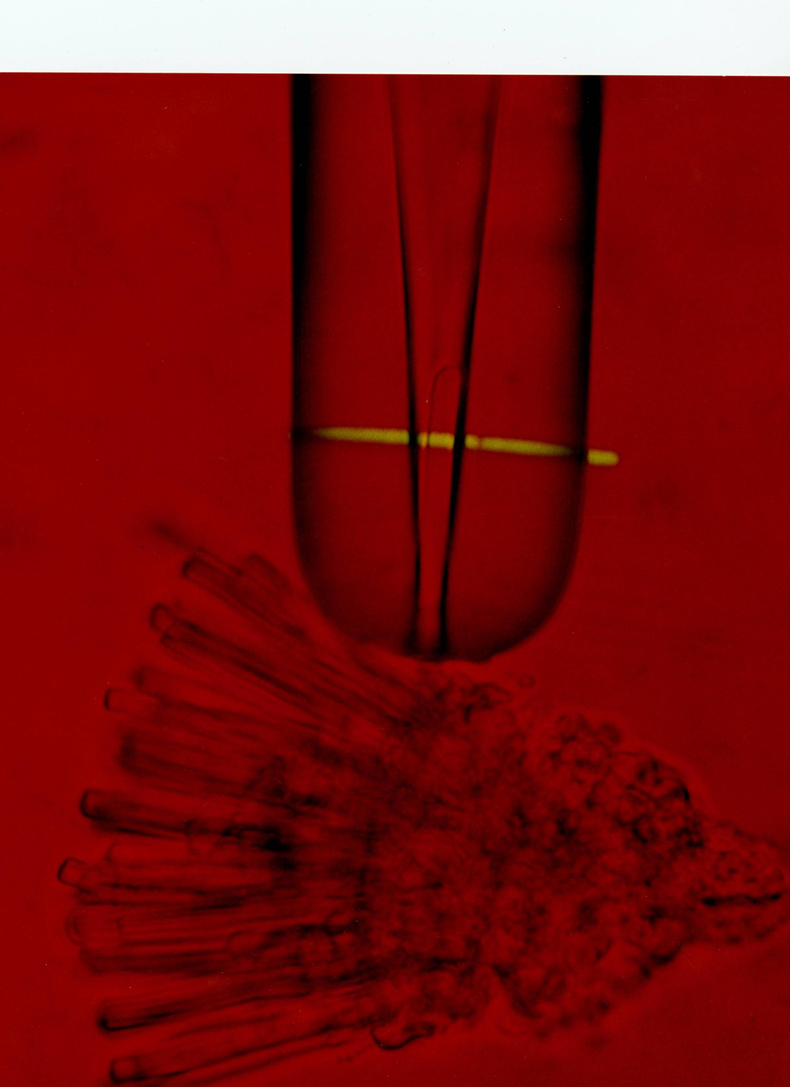
How will a neuron respond to a stimulus?
Baylor, Lamb and Yau (1979)
Notes:
This is a single photoreceptor sucked up into a glass pipette. One of Denis Baylor’s postdocs is at the other end (buffered by a micromanipulator) recording currents passing across the membrane in response to a flash of light (yellow bar).

Slide 11
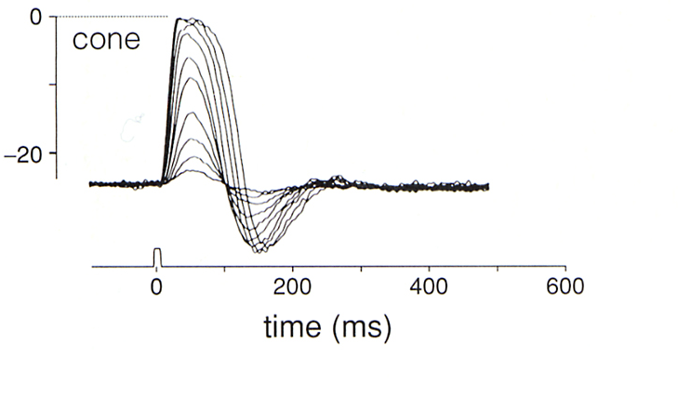
How will a neuron respond to a stimulus?
Single photoreceptor responses to a flash of light
Photocurrent
pA
Baylor (1987)
Notes:
The photoreceptor has a range in the middle where the response curve is approximated by a line - ‘the linear range’. The following slides focus on this linear range.

Slide 12
A linear system
s₁
F(s₁)
F
s₂
F(s₂)
F
s₁ + s₂
F(s₁ + s₂)
F
The Superposition Principle
When two inputs are presented to a linear system, their effects sum.
Notes:
This is the definition of a linear transformation, applicable to any transformation, not just those occurring in the nervous system.
No matter what the function “F” is, if the function, or system, is linear, the effects of two inputs will sum. This, of course also applies to any number of inputs. Or if an input is doubled in size, the response will double.
This principle also means that if you know the response to one input, such as an impulse, you can predict the response to any input. This also means that knowing the response to an input, such as a brief impulse, gives a complete characterization of the entire response.
One can consider what synaptic physiologists often do, the cause a presynaptic cell to spike, and measure the effect of the synapse (synaptic potential) in the postsynaptic cell. Although synapses are not really linear, the same sort of thinking is going on, that if you measure the response to one input, that tells you something about what will happen for a large set of other inputs.

Slide 13
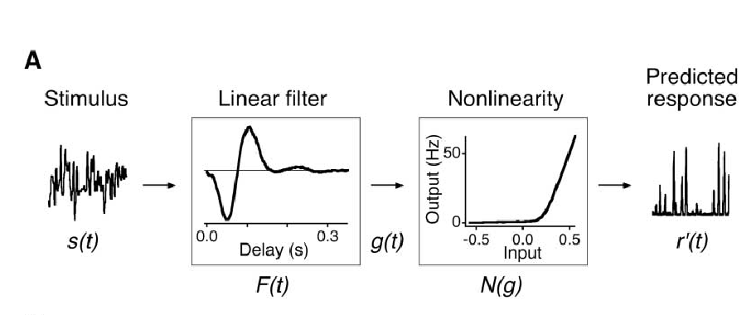
A linear model of the cell’s response
Convolution
F(t) is called:
Impulse response function
Linear kernel
First-order kernel
First-order Wiener kernel
Notes:
The function called a ‘Linear Filter’ can be thought of as the response to a brief impulse. It’s also called the ‘impulse response function’.
The term ‘filter’ deserves some explaining, why filter? The most general sense of a filter, is something that extracts elements from a set. A swimming pool filter extracts leaves, an audio filter extracts some frequencies of sounds and a Whatman filter in a biochemistry labs extracts large particles. A little more precisely, a filter applies a weighting to this operation, so that really small particles the lab pass through easily, large particles do not pass through, intermediate size particles pass through at a slower rate. In same way, a linear filter in this context applies a weighting to the previous inputs. Some inputs in the past are weighted strongly, some more weakly, some are given negative weight. Thus, the filter applies a weighted sum over the most recent inputs.

Slide 14
Like we did with the reverse correlation above, let’s take the discrete convolution, it’s easier to do calculations by hand. Here, we’re considering that the length of the linear temporal filter is 1 second.
t: time, the variable that indicates the time during the experiment, so if the experiment is 60 s long, t varies between 0 and 60 s.
τ: the summation variable that indicates time relative to the filter. Because the filter is 1 s long, τ varies between t-1 and t second.
r’(t): predicted response at time t
S(τ): stimulus at time point τ. Note that since τ varies between t-1 and t, s(τ) is summed over the previous one second to compute r’(t).
F(t- τ): The Filter at time t- τ. Since τ varies between t-1 and t, F(t-τ) is actually summed between F(1) and F(0).
To compute r’(t), the sum is taken over τ=t-1 and τ=t. Thus the sum is computed across :
and
So the stimulus is multiplied by the time-reverse of the filter. Then all points are summed. In this way, the filter weights the stimulus over the previous one second, according to the filter’s time course. It’s instructive to work out a very simple example.
Let’s say the stimulus is five time points long s=(0,1,1,1,0), i.e. s(0)=0,s(1)=s(2)=s(3)=1,s(4)=0.
The filter is two time points long (1,-1), i.e. F(0)=1, F(1)=-1. τ goes from t-1 to t. Then,
Stimulus Filter reversed in time Response
s(0)=0 F(1)=-1
s(1)=1 F(0)=1 r(1) = s(1)*F(0)+s(0)*F(1) = 1
s(2)=1 r(2) = s(2)*F(0)+s(1)*F(1) = 0
s(3)=1 r(3) = s(3)*F(0)+s(2)*F(1) = 0
s(4)=0 r(4) = s(4)*F(0)+s(3)*F(1) = -1
Note that this filter has essentially taken the derivative of the stimulus, taking (0,1,1,1,0) as an input, generating (1,0,0,-1) as an output

Slide 15
Filters and step responses
Monophasic
Biphasic
Two different algorithms for convolution
Impulse response
Dot product with time-reverse of filter
How do you find the filter?
What stimulus produces the largest response?
geometrical interpretation

Slide 16
Summary of relationship between the response to an impulse and the most effective input.
For a cell (or any system) responding in the linear range, the response to a brief input (an impulse):
yields the time-reverse of the sequence of inputs that the cell is most sensitive to:
Notes:
This is just a mathematical statement about a linear system, but one that’s interesting to think about in the context of real neurons, molecules or synapses. The clause ‘the sequence of inputs that the cell responds to with the highest gain’ more explicitly refers the following: For an input of a given standard deviation (amplitude) the input that yields the largest magnitude response.

Slide 17
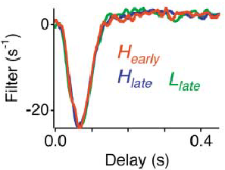
A linear model of the cell’s response
Stimulus Linear filter Predicted response
Time (s)
Photoreceptor
Linear model
Notes:
Here’s a linear model at work. In response to Gaussian white noise random flicker photoreceptors are quite linear. They are not linear in response to other stimuli, such as those that greatly change intensity or stay at one intensity for long periods of time.

Slide 18
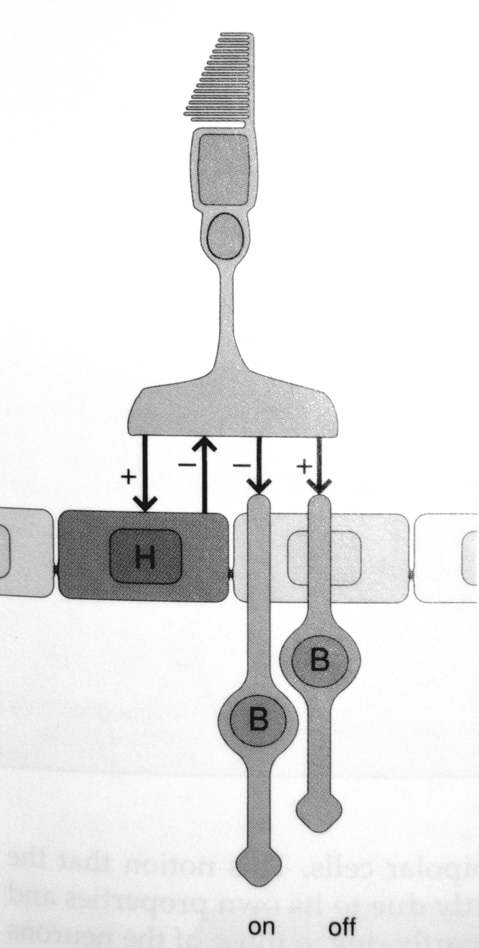
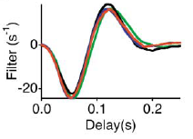
Linear filters in the early visual system
Photoreceptor
P
Horizontal cell
Bipolar cell
Weighted sum of
Photoreceptor and Horizontal
Cell filters
Notes:
These linear filters are all calculated relative to the visual stimulus by reverse correlation with a Gaussian white noise stimulus. These were done in different experiments. The Bipolar cell is the one labelled “Off” in the diagram, so that all three cells hyperpolarize (become more negative) in reponse to a brief flash of light. The photoreceptor terminal receives negative (inhibitory) input from the horizontal cell, but input is not recorded at the photoreceptor cell body. So the photoreceptor filter does not reflect the horizontal cell input, but the bipolar cell input reflects a positive input from the photoreceptor, and a negative, indirect input from the horizontal cell.
If all of these operations were linear relative to the stimulus, we would expect their effects to sum, so that the bipolar filter would look a weighted sum of the photoreceptor filter (P) and the horizontal cell filter (H). What’s not determined here is how the sum should be weighted. We know P should be positive and H should be negative from the signs of the synapses, but we don’t know how strong those synapses are. Just for this class, I just scaled the filters to verify that we could get a close approximation of the time course of the bipolar cell using the P and H filters. Looks pretty good. This verifies that a weighted sum of these two inputs can account for the bipolar cell response. These filters are normalized, so the specific numbers (1.9 P and -1.3 H) of the best fit aren’t meaningful without accounting for the amplitude of each cell’s response, which I didn’t do.
All these three cells will behave nonlinearly if the stimulus changes greatly in intensity for an extended period of time, but for the fast fluctuations used here, the cells are mostly in the linear range.

Slide 19
Nonlinear summation of inputs by a static nonlinearity
Input
Filter
Nonlinearity
Response
Linear summation
Time
Time
Time
Expansive
(accelerating)
Supralinear summation
Compressive
(saturating)
Sublinear summation
Notes:
Examples of nonlinear summation.
This introduces the concept of a downstream static nonlinearity, applied after the linear filter. ‘Static’ means time-independent, it transforms the input point by point, no signals are combined over time. Input is on the x-axis, output on the y-axis, just like any other simple function.
Remember the different types of summation when we later talk about how synaptic inputs are summed in dendrites.

Slide 20
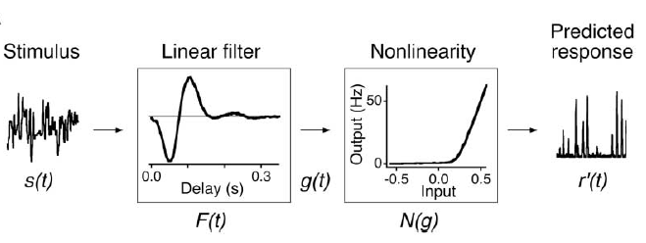
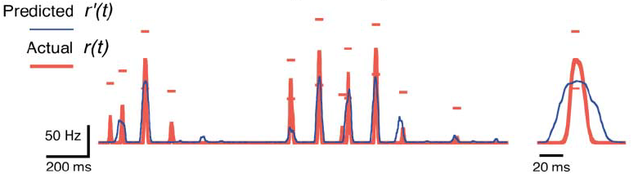
Linear - Nonlinear “LN” model of a “Feature Selective Neuron”
Retinal ganglion cell firing rate and LN model
Notes:
This Linear-Nonlinear model is a commonly used simple description in the nervous system here it is shown for a salamander retinal ganglion cell. The LN model is calculated as follows:
1) The linear filter is calculated by correlating the ganglion cell firing rate with a uniform-field Gaussian white noise stimulus.
2) A linear estimate of the cell’s response (g(t), not shown here) is calculated by convolving the linear filter with the stimulus.
3) Then the actual response r(t) is plotted point by point against the linear estimate, g(t). For each value of the linear estimate, g(t), there are a set of points in the response, r(t), that occurred at the same time. The nonlinearity, N(g(t)), is the average of those points at each value of the linear estimate, g(t). So g(t) is the input N(g) and the predicted response r’(t) is the output.
The model at top is from Baccus & Meister (2002).
The bottom plot shows the comparison of the model and the actual cell’s firing rate. The model is in red, I think I got this right in class (legend now added). The plot below is from the Chichilnisky paper, but it’s the same type of model as shown at top. So don’t look to correspond the values of the points between the model at top and plot below.

Slide 21
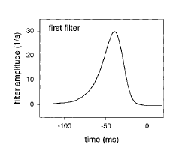
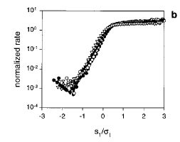
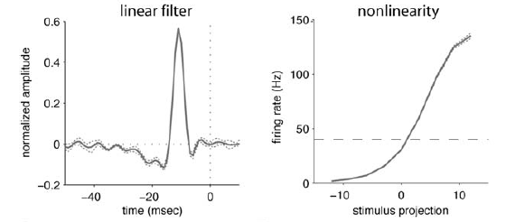
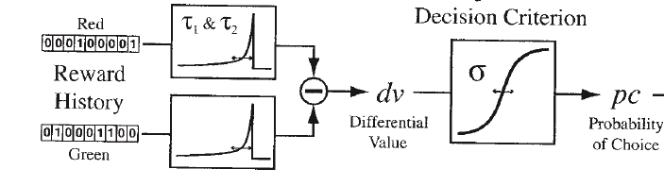
LN models in the nervous system
“Filter”
Nonlinearity
Fly H1 Motion
sensitive neuron
Brenner et al.,, Neuron (2000)
Songbird auditory forebrain neuron
Nagel & Doupe, Neuron (2007)
Whole monkey
making decisions
Corrado, Sugrue, Seung & Newsome, J. Exp. Anal. Behav. (2005)
Notes:
Different examples of the LN models from different systems using different stimuli.
Fly H1: Here, the stimulus variable is not light intensity, but motion velocity. This cell encodes motion velocity linearly, but saturates at high positive velocities.
Auditory Neuron: The stimulus variable here is sound amplitude. A broadband noise is used, but it’s amplitude is modulated according to a Gaussian white noise distribution. Then the correlation is done relative to the sound amplitude.
Whole monkey: Here, the monkey is making choices (red vs green spots) in order to get rewards (liquid). Whether the monkey gets rewarded for red or green changes over time, and the monkey doesn’t know color will be rewarded. The monkeys behavior is predicted by a simple linear filter weighting the history of rewards over time followed by a static nonlinearity. There’s also a stage of noise added at the end not shown here.

Slide 22
Properties of feature detection
Selectivity
Invariance

Slide 23
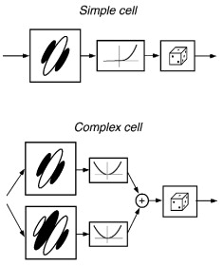
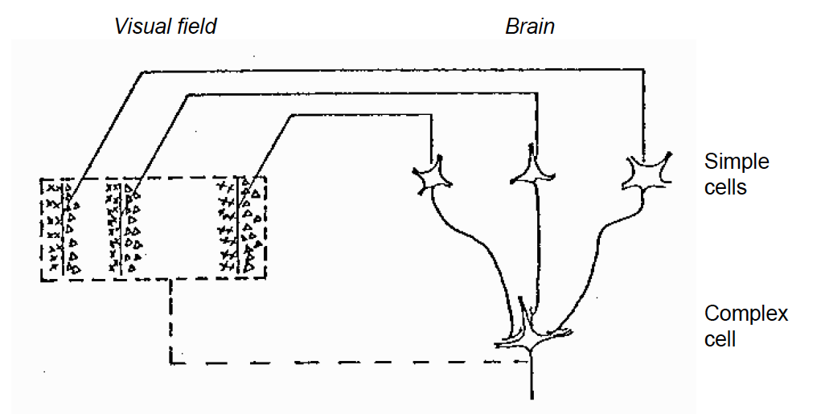
Models of selectivity and invariance in primary visual cortex
Hubel & Wiesel, 1963
Rust et al., 2005

Slide 24
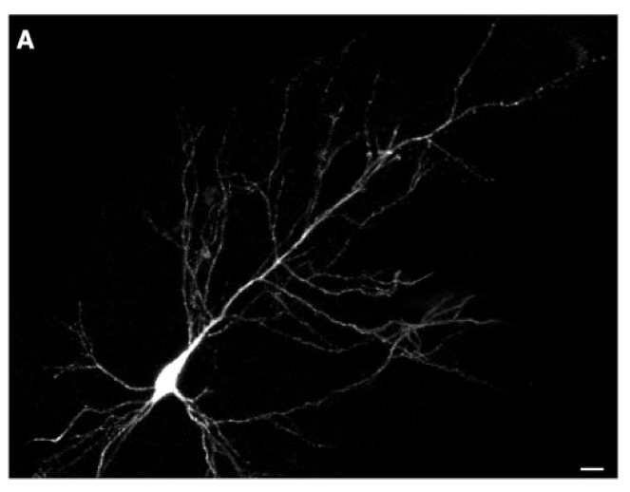
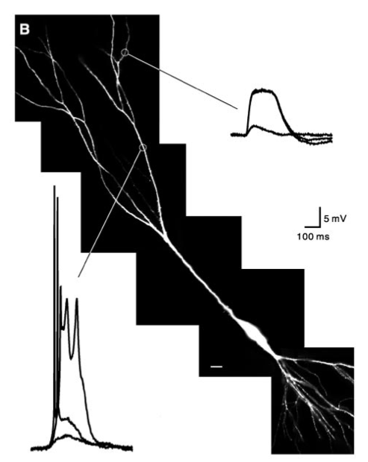
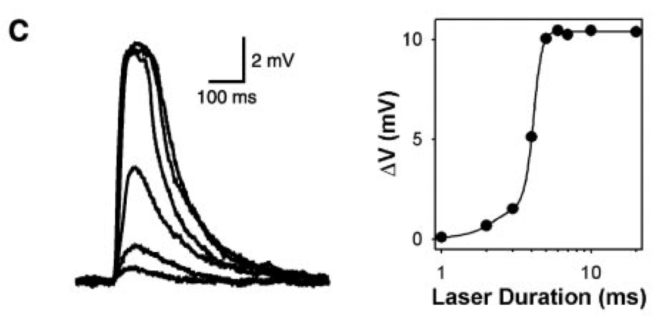
All or none calcium action potentials in pyramidal cell dendrites
Wei et al., 2001. Compartmentalized and Binary Behavior of Terminal Dendrites in Hippocampal Pyramidal Neurons
Notes:
Calcium action potentials can be measured in some dendrites. Here, caged glutamate is being released onto a cell. This is a synthetic glutamate analog that is inactive, because there is an additional molecule attached to the glutamate. When light is absorbed by the molecule, it cleaves, releasing glutamate that then can bind to glutamate receptors.
Calcium action potentials occur when the cell depolarizes sufficiently to open a large calcium current, which then further depolarizes the cell producing positive feedback. Eventually (~50 – 100 ms) calcium channels inactivate (close), even though the cell is still depolarized, thereby ending the action potential.

Slide 25
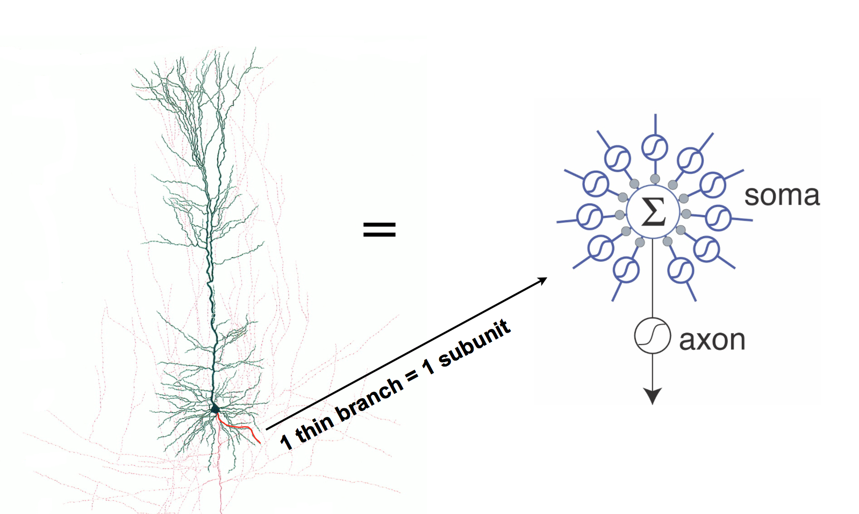
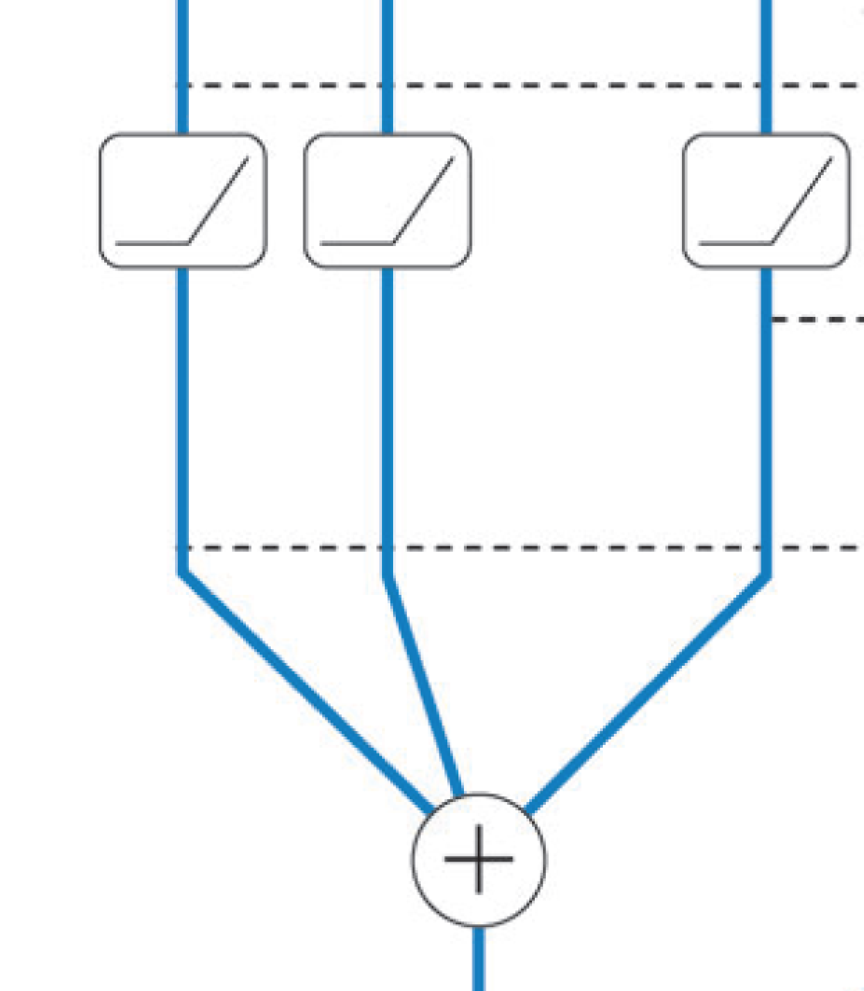

“Two layer” model of active dendrites
dendrites
soma
axon
Poirazi, Brannon & Mel, 2003
Bartlett Mel

Slide 26
Analyzing the spike-triggered stimulus ensemble
Gaussian distribution
1
Light intensity
0
STA
0

Slide 27
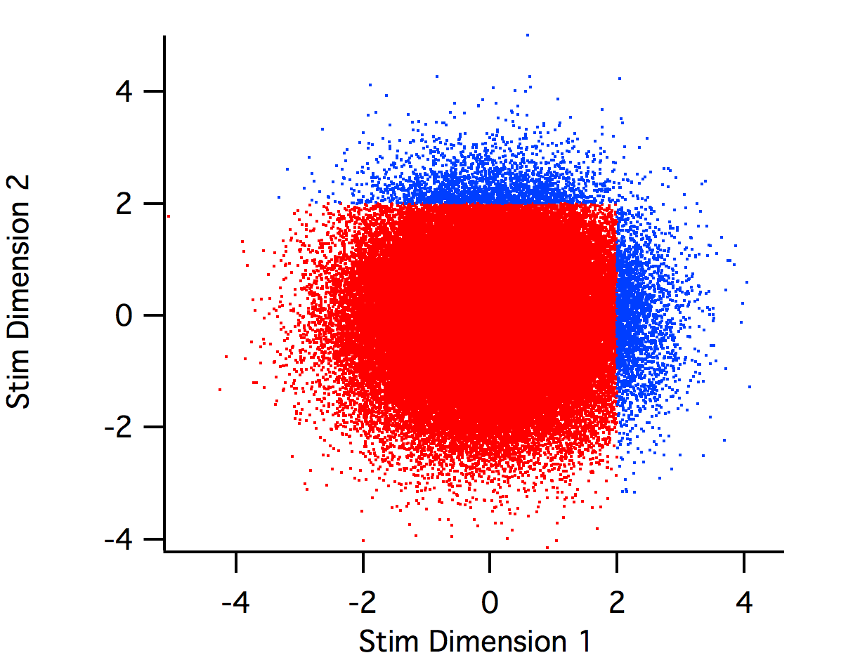
Sensitivity to multiple stimulus dimensions

Slide 28
Spike-triggered Covariance

Slide 29
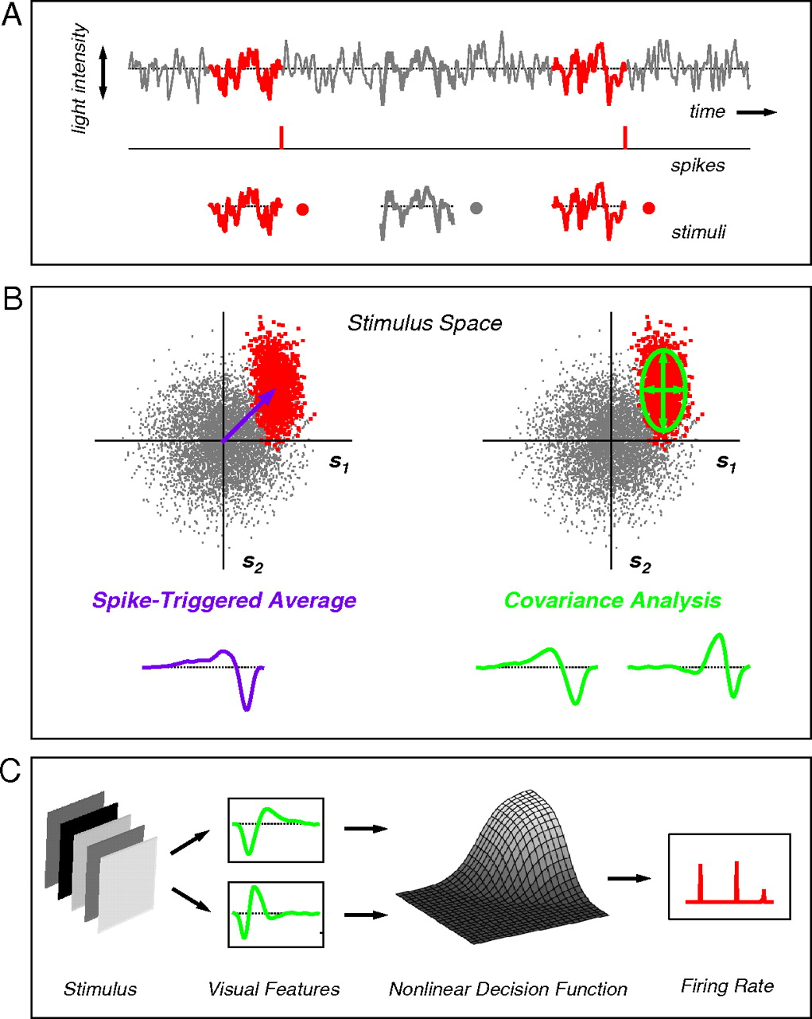
Fairhall et al, 2006

Slide 30
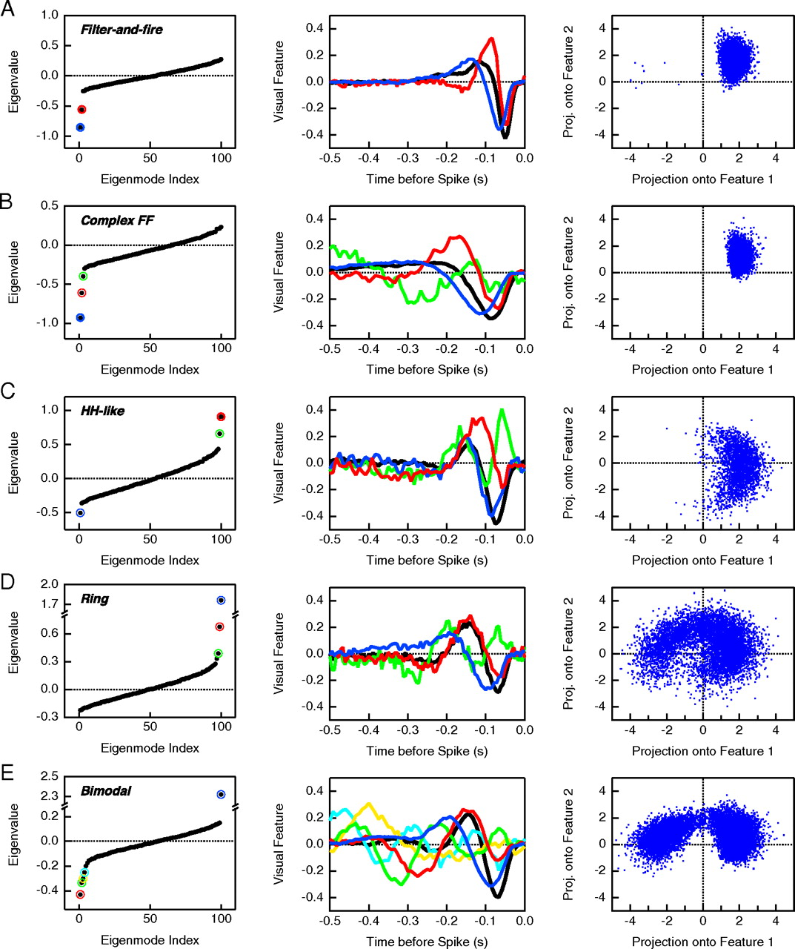

Slide 31
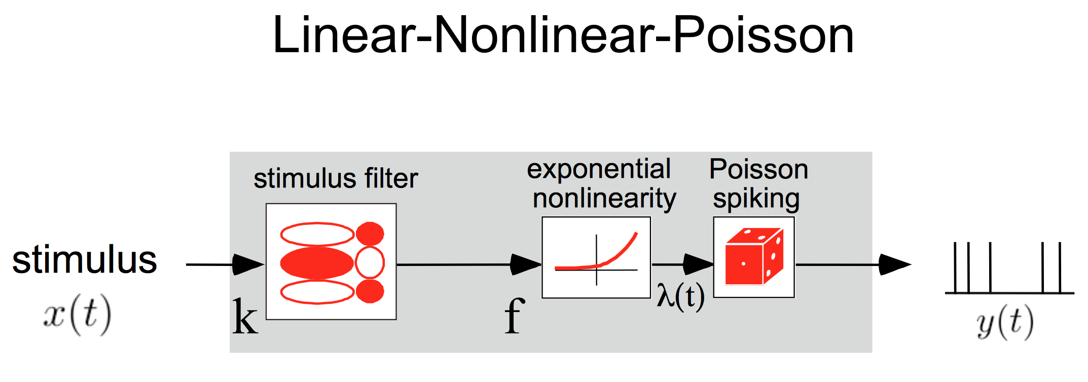
Nonlinearity

Slide 32
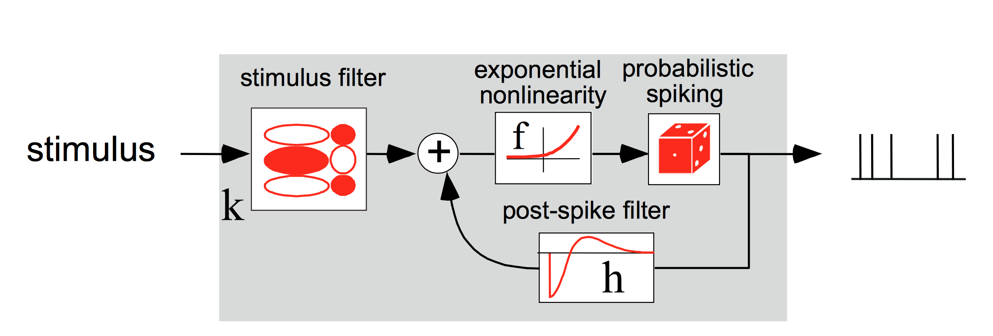
Generalized Linear Model
A form of LN model
Can be optimized, don’t need Gaussian input
Is “convex”, meaning there are no local minima
Only works with “exponential family” distribution of
responses, restricted nonlinearities
Primer on various encoding methods, Aljadeff et al., Neuron, 2016

Slide 33
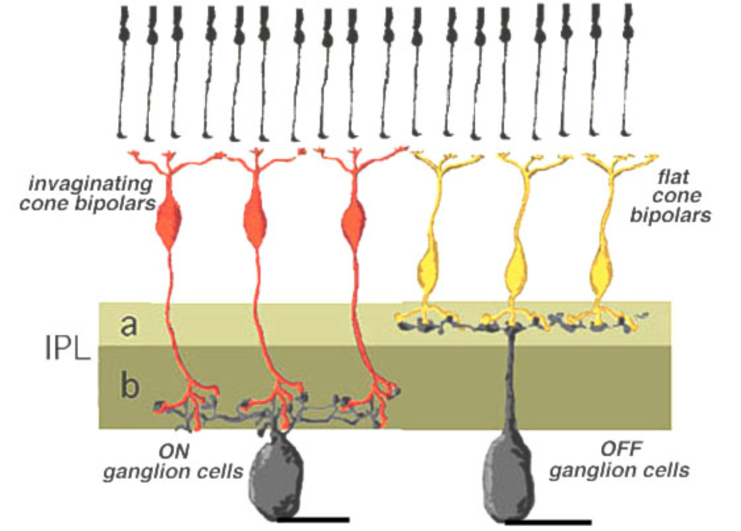

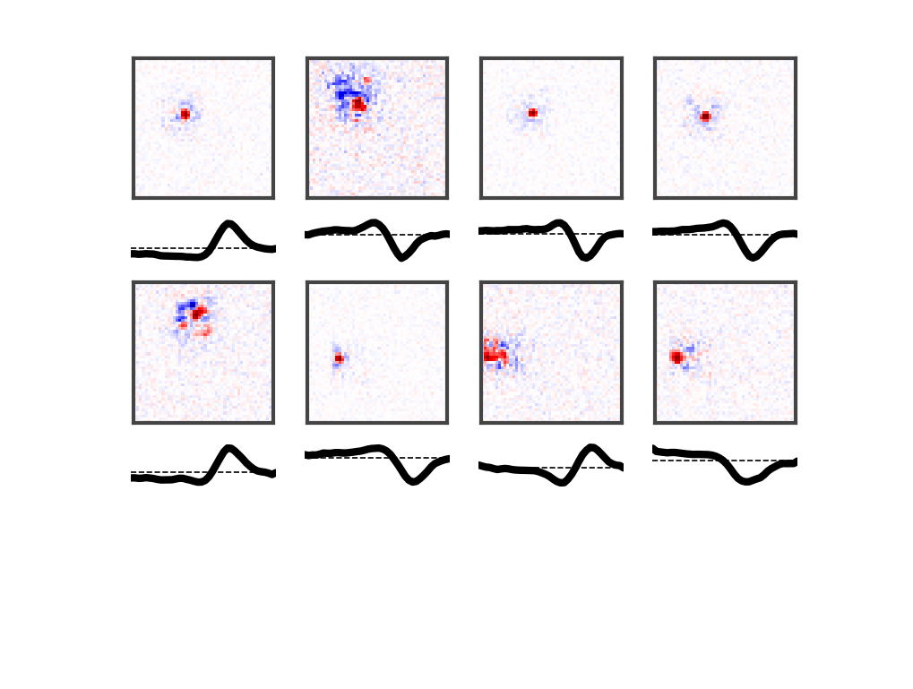
A Simple Model of Visual Responses
Linear-Nonlinear (LN) Model
Receptive Field
Spatiotemporal
Filter
Cone
Synaptic
weights
w₁
w₂
w₃
Bipolar cell
Time
Preferred
Visual feature
Ganglion cell

Slide 34
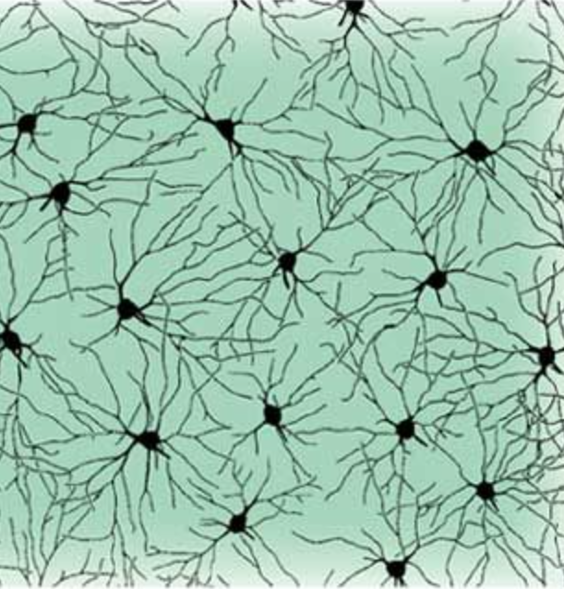
“Convolutional” layer
Like a mosaic
of retinal neurons

Slide 35
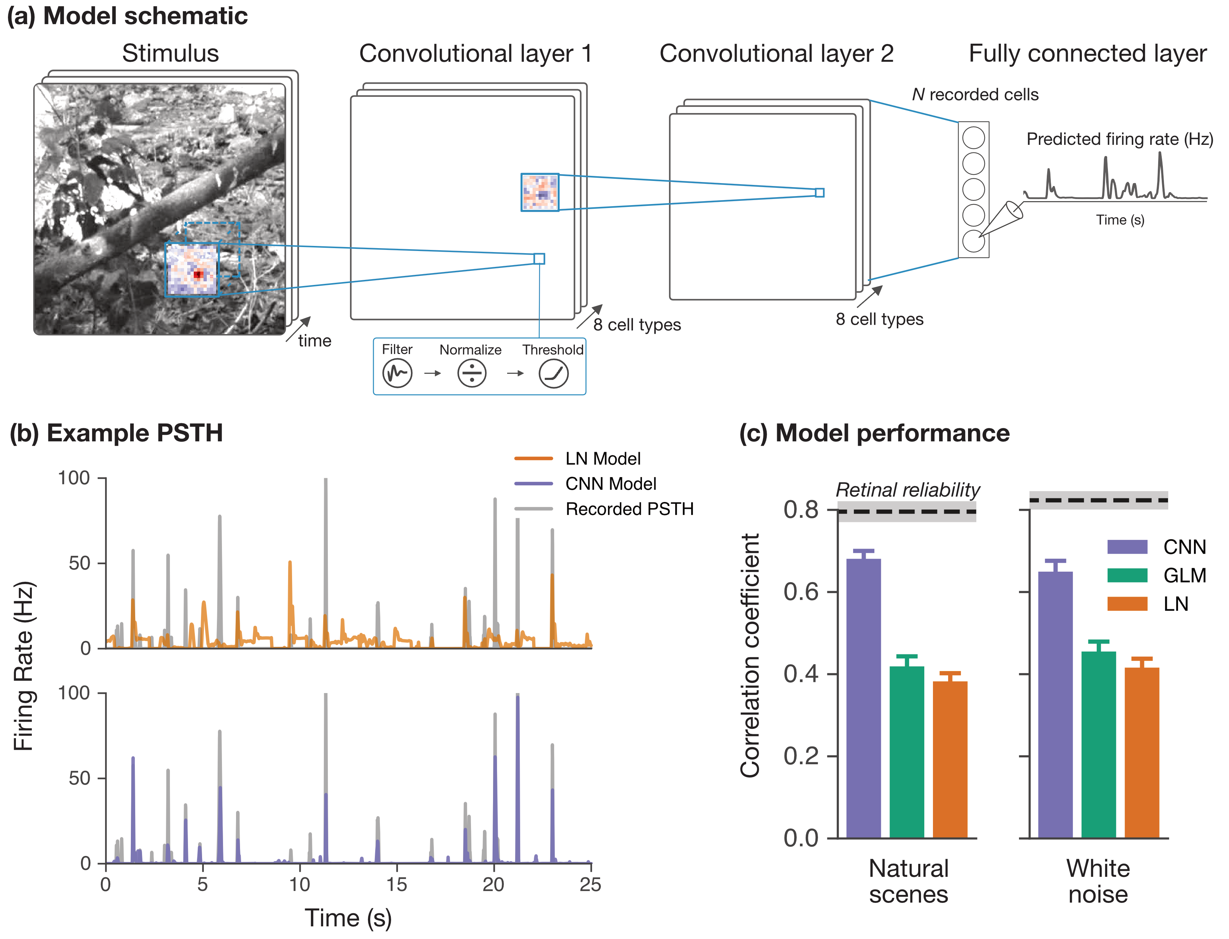
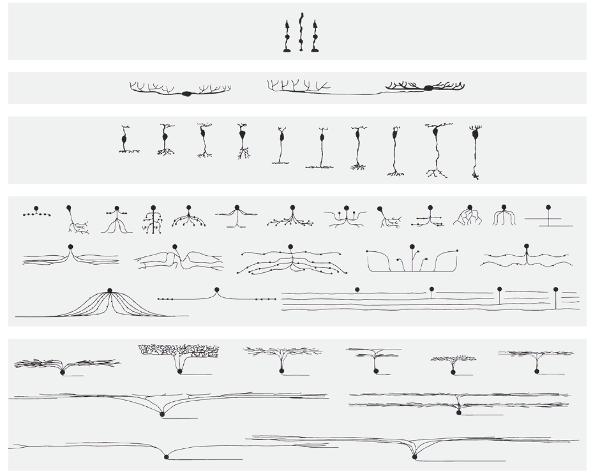
Multiple cell types
A
Multiple
cell types
Filter Scale Threshold
Like the multiple cell types in the retina
L

Slide 36
Multiple Layers
A
Multiple
cell types
Filter Scale Threshold
L
Like the multiple cell types in the retina
Like the hierarchy of retinal circuitry

Slide 37

Object Recognition Deep Network

Slide 38
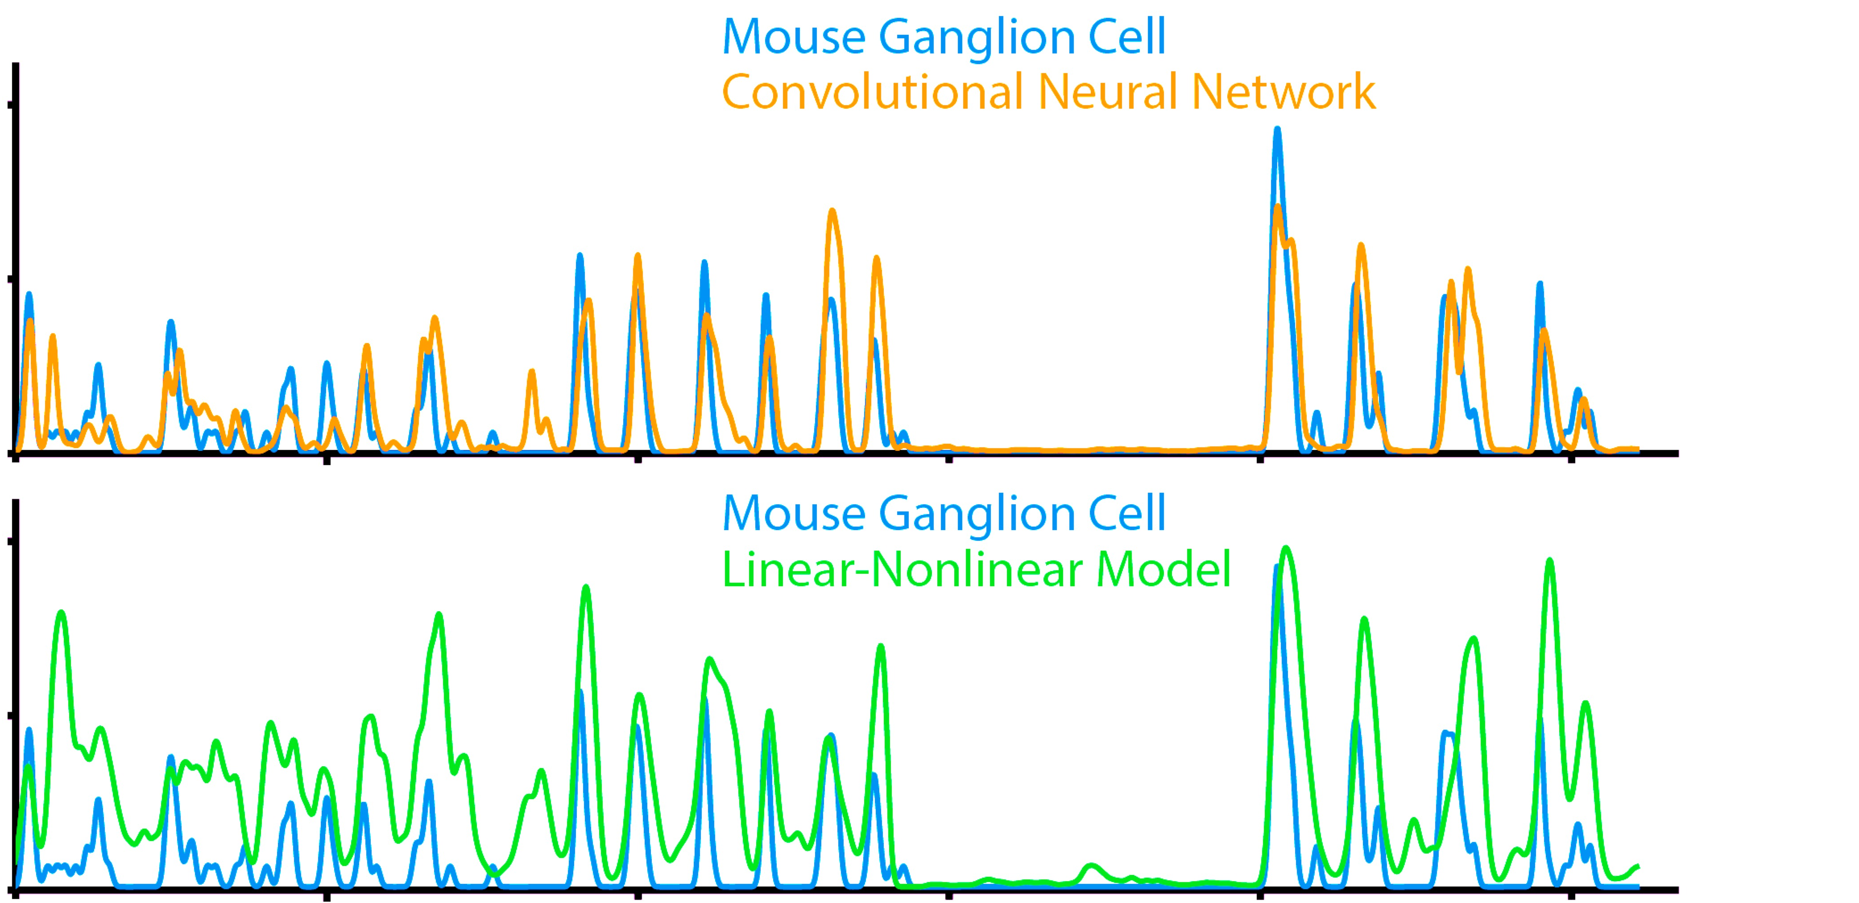
Convolutional Network Model of the Retina
A
Niru Maheswaranathan
Lane McIntosh
Surya Ganguli
Filter Scale Threshold
Salamander
Mouse
Salamander
100
Data CNN model
60
Data CNN model
0
Rate (Hz)
Data LN model
0
100
Rate (Hz)
60
Data LN model
0
0
0
10
20
0
6
12
Time (s)
Time (s)
CNN
GLM
LN
McIntosh, L., et al., (NIPS 2016), Maheswaranathan et al., (biorxiv 2018).

